Slide 1
NAÏVE BAYES CLASSIFICATION
By : Ayush Tyagi

Slide 2
OUTLINE
BAYES THEOREM
NAÏVE BAYES CLASSIFIER
ASSUMPTIONS
THE MATHEMATICS BEHIND NAÏVE BAYES
A SAMPLE PROBLEM
ADVANTAGES OF NAÏVE BAYES
DISADVANTAGES OF NAÏVE BAYES
LAPLACE SMOOTHING
CONCLUSION

Slide 3

Bayes theorem
Bayes’ Theorem is a simple mathematical formula used for calculating conditional probabilities.
Conditional probability is a measure of the probability of an event occurring given that another event has occurred.
Given two events A and B,
$P(A \text{| }\text{B}\text{) = }\text{P}\text{(}\text{B}\text{ | }\text{A}\text{) }\frac{P(A)}{P(B)}$
Here,
P(A | B) = Probability of event A happening given that event B has happened
P(B | A) = Probability of event B happening given that event A has happened
P(A) = Probability of event A happening
P(B) = Probability of event B happening

Slide 4
Naïve bayes classifier
Naïve Bayes algorithm is a supervised learning algorithm based on Bayes theorem and is used for solving classification problems.
Naïve Bayes Classifier is one of the simple and most effective Classification algorithms which helps in building fast machine learning models that can make quick predictions.
It is a probabilistic classifier, which means it predicts on the basis of the probability of an object.
Some popular applications of Naïve Bayes Algorithm are spam filtration, Sentimental analysis, and classifying articles

Slide 5
ASSUMPTIONS
The fundamental Naive Bayes assumption is that each feature makes an independent and equal contribution to the outcome. This is known as the Naive assumption.
Note: The assumptions made by Naive Bayes are very strong assumptions and are not generally correct in real-world situations. In fact, the independence assumption is never correct but often works well in practice.

Slide 6

The mathematics behind naïve BAYES
Consider a dataset with $n$features namely $f_{1}, f_{2},{ f}_{3},.…..,f_{n−1}, f_{n}$
Consider a datapoint with feature $X=\left( X_{1}, X_{2}{ X}_{3},.…..,X_{n−1}, { X}_{n}\right)$ and class variable $Y$ the Bayes theorem states that
$$P(Y \text{| }\text{X}\text{) = }\text{P}\text{(}\text{X}\text{ | }\text{Y}\text{) }\frac{P(Y)}{P(X)}$$
We’re interested in calculating the posterior probability $P\left(Y \right| X)$ from the likelihood $P\left(X \right| Y)$and prior probabilities $P(Y)$ and $P(X)$.

Slide 7

Using the chain rule, the likelihood $P\left(X \right| Y)$can be decomposed as :
$P\left(X | Y\right)=P(X_{1},X_{2},….. ,X_{n}| Y)$
$$=P\left(X_{1} | X_{2},….. ,X_{n}, Y\right)∗P\left(X_{2} | X_{3},….. ,X_{n},Y\right)∗_______∗P(X_{n}| Y)$$
but because of the Naïve assumption, the conditional probabilities are independent of each other .
Therefore
$P\left(X \right| Y)=$ $P\left(X_{1}|Y\right).P\left(X_{2}|Y\right)…..{P(X}_{n}|Y)$

Slide 8

Thus by conditional independence , we have
$P\left(Y | X_{1}, X_{2},……., X_{n}\right)= \frac{P\left(X_{1}|Y\right).P\left(X_{2}|Y\right)…..{P(X}_{n}|Y)}{P\left(X_{1}\right) P\left(X_{2}\right)…..{P(X}_{n})} P(Y)$
Therefore we can write it as
$P\left(Y | X_{1}, X_{2},……., X_{n}\right)=\frac{\prod_{i=1}^{i=n}{P(X_{i}|Y)} }{P\left(X_{1}\right) P\left(X_{2}\right)…..{P(X}_{n})} P(Y)$
Therefore we have
$P\left(Y | X_{1}, X_{2},……., X_{n}\right)∝ \prod_{i=1}^{i=n}{P\left(X_{i} | Y\right) }P(Y)$
(because $P\left(X_{1}\right) ∗P\left(X_{2}\right)∗…∗{P(X}_{n})$is constant )
Therefore
$$Y=argmax\prod_{i=1}^{i=n}{P(X_{i}|Y)} P(Y)$$

Slide 9
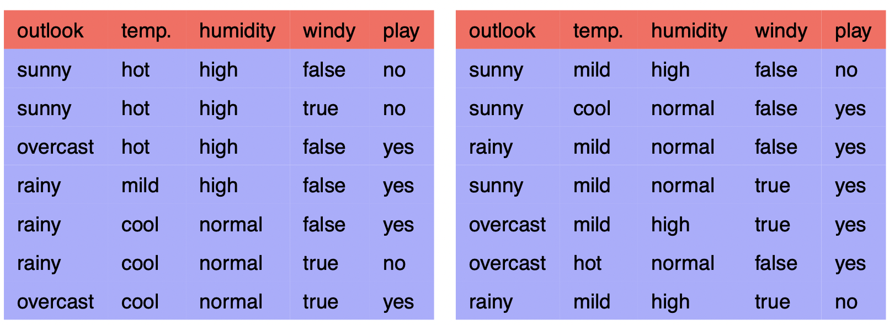
A SAMPLE PROBLEM
Consider a fictional data set that describes the weather conditions for playing some unspecified game. The dataset is as follows ....

Slide 10
Frequencies and probABILITIES
Now we need to calculate the frequencies and probabilities for the given data.
There are a total of 14 data points in our dataset.
The frequencies for the outlook feature are
Outlook | Yes | No | Total
Sunny | 2 | 3 | 5
Overcast | 4 | 0 | 4
Rainy | 3 | 2 | 5
Total | 9 | 5 | 14

Slide 11

The corresponding probabilities which can be calculated from the above table are as follows . . . . . .
$P\left(yes\right)=\frac{9}{14}$
$P\left(no\right)=\frac{5}{14}$
$P\left(sunny | yes\right)=\frac{2}{9}$ and $P\left(sunny | no\right)=\frac{3}{5}$
$P\left(overcast | yes\right)=\frac{4}{9}$ and $P\left(overcast | no\right)=0$
$P\left(rainy | yes\right)=\frac{3}{9}$ and $P\left(rainy | no\right)=\frac{2}{5}$.

Slide 12
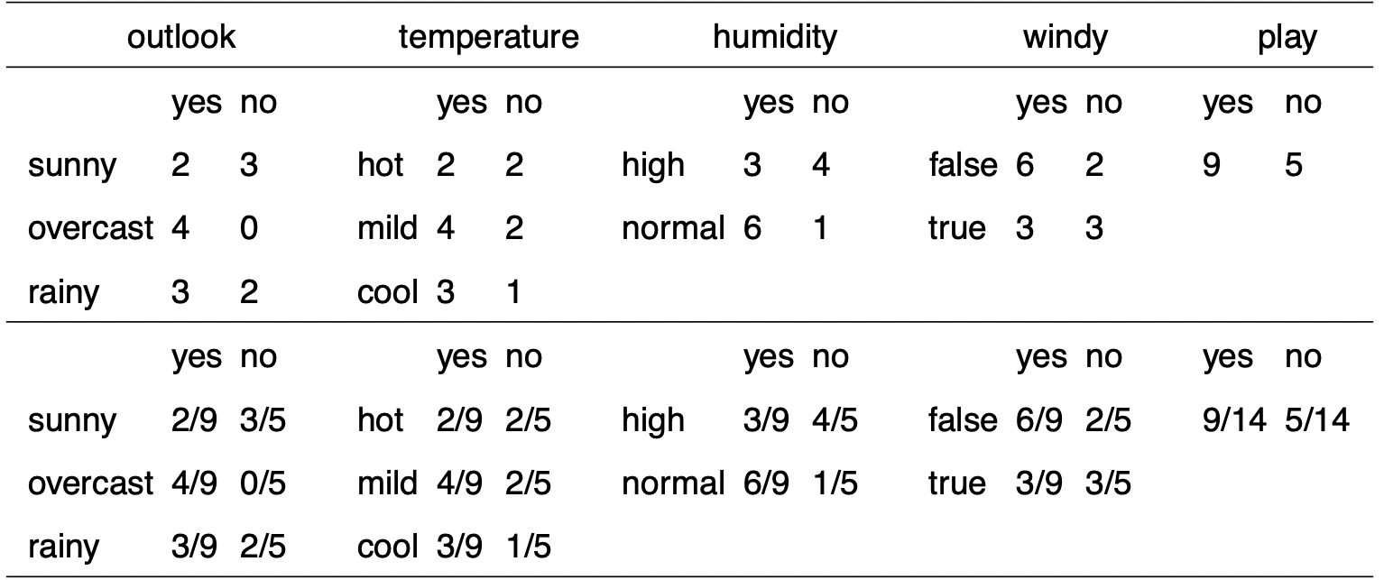
Frequencies and probabilities
Similarly we can calculate the conditional probabilities of all the features .
The Frequencies and probabilities for the weather data is :

Slide 13
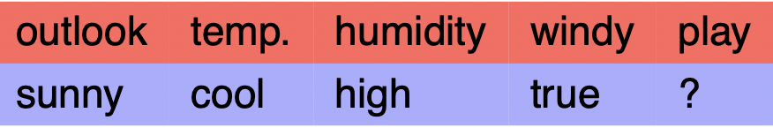

Now assume that we have to classify the following new instance:
We have
$$Y=argmax\prod_{i=1}^{i=n}{P(X_{i}|Y)} P(Y)$$
The possible values of output class could be either yes or no, therefore
We need to compute a probability for each class based on the probability distribution in the training data i.e. We need to calculate
$P\left(Y=yes \right| outlook=sunny, temp=cool, humidity=high, windy=true )$
and $P\left(Y=no \right| outlook=sunny, temp=cool, humidity=high, windy=true )$

Slide 14

We need to calculate
$$\prod_{i=1}^{i=n}{P(X_{i}|yes)} P\left(yes\right) and. \prod_{i=1}^{i=n}{P\left(X_{i} \right| no)} P(no)$$
Calculating
$$. \prod_{i=1}^{i=n}{P\left(X_{i} \right| no)} P(no)$$
We have
$P\left(sunny \right| no)∗P\left(cool\right| no)∗P\left(high \right| no)∗P\left(true \right| no)∗P(no)$ = $\frac{3}{5}∗\frac{1}{5}∗\frac{4}{5}∗\frac{3}{5}$ *$\frac{5}{14}$
$=0.0577$

Slide 15


$$\prod_{i=1}^{i=n}{P(X_{i}|yes)} P\left(yes\right) can be calculated as follows$$
=$P\left(sunny \right| yes)∗P\left(cool\right| yes)∗P\left(high \right| yes)∗P\left(true \right| yes)∗P(yes)$ = $\frac{2}{9}∗\frac{3}{9}∗\frac{3}{9}∗\frac{3}{9}$ *$\frac{9}{14}$
$=0.0082$
Therefore we have
$$\prod_{i=1}^{i=n}{P(X_{i}|yes)} P\left(yes\right) < \prod_{i=1}^{i=n}{P\left(X_{i} \right| no)} P(no)$$
This means that the given test case will be classified as “NO”.

Slide 16
Advantages of Naive Bayes
1. When the assumption of independent predictors holds true, a Naive Bayes classifier performs better as compared to other models. 2. Naive Bayes requires a small amount of training data to estimate the test data. So, the training period is less. 3. Naive Bayes is also easy to implement.

Slide 17
Disadvantages of Naive Bayes
1. The Main imitation of Naive Bayes is the assumption of independent predictors. Naive Bayes implicitly assumes that all the attributes are mutually independent. In real life, it is almost impossible to get a set of predictors which are completely independent. 2. If the categorical variable has a category in the test data set, which was not observed in the training data set, then the model will assign a 0 (zero) probability and will be unable to make a prediction. This is often known as Zero Frequency.

Slide 18

LAPLACE SMOOTHING
It is introduced to solve the problem of zero probability i.e. when a query point contains a new observation, which is not yet seen in training data while calculating probabilities.​
The idea behind Laplace Smoothing: To ensure that our posterior probabilities are never zero, we add $α$ to the numerator, and we add $αK$ to the denominator. So, in the case that we don’t have a particular ingredient in our training set, the posterior probability comes out to $\frac{α}{N+αK}$ instead of zero. Plugging this value into the product doesn’t kill our ability to make a prediction as plugging in a zero does.​
Here, alpha(α) represents the smoothing parameter.
K represents the dimensions(no of features) in the data.
N represents the number of reviews with the target outcome.
If we choose a value of α != 0 (not equal to 0), the probability will no longer be zero even if the category was not observed in the training dataset .

Slide 19

Now consider that we have to classify the following instance ​
Since our training data hasn't seen snow as an outlook​.
Thus we have ​ $P\left(snow \right| yes)=0$and $P\left(snow \right| no)=0$.
Therefore the probability for both the classes turns out to be 0 and hence we have encountered the zero frequency problem of Naïve bayes.
Therefore we should use Laplace smoothing in order to handle the zero frequency
Thus we should have $P\left(snow \right| yes)=\frac{α}{N+αK}$ where $N$ is the number of outlooks with target outcome as yes.
Similarly, we have $P\left(snow \right| yes)=\frac{α}{M+αK}$ where $M$ = number of outlooks with target outcome as No.
Usually we take $α=1$ .
Outlook | Temperature | Humidity | Windy | Play
Snow | Cool | High | True | ?

Slide 20
CONCLUSION
Naïve Bayes is a probabilistic machine learning algorithm based on the Bayes Theorem, used in a wide variety of classification tasks. These models are fast and easy to implement but their biggest disadvantage is that the requirement of predictors to be independent. In most of the real life cases, the predictors are dependent, this hinders the performance of the classifier. Laplace Smoothing can be used to tackle the zero frequency problem.

